Slide 1
Securing ACME Corp:
A Strategic Plan
Group 6
Anmol Singh System Administrator | Abbas Hussain Syed System Administrator | Solomon Mithra System Administrator

Slide 2
Executive Summary
Recent vulnerability scans and security assessments have identified significant risks in ACME Corp's current infrastructure and processes. As the systems administrator, we are proposing a comprehensive security plan to mitigate these threats and protect our valuable data and systems.

Slide 3
Risks Identified
Potential Impacts
Critical vulnerabilities in Metasploitable 2011 operating system (Nessus findings attached)
Lack of network segmentation and access controls
Outdated/unpatched software and operating system
No formal incident response or disaster recovery plan
Absence of documented security policies/standards
Data breaches/theft of sensitive information
System outages and downtime
Regulatory compliance violations
Damaged reputation and customer trust
Significant financial losses

Slide 4
Proposed Security Enhancements
4.1 Network Security
4.2 System Hardening
Implement firewalls and intrusion detection/prevention systems
Segment network with VLANs and DMZs to restrict access
Enable encrypted communications with VPNs and SSL/TLS
Filter/restrict inbound/outbound traffic as per policies
Patch management program for timely software updates
Secure system configurations and hardening guides
Endpoint protection (anti-virus, anti-malware)
Vulnerability scanning and penetration testing

Slide 5
4.3 Access Controls:
4.4 Policy & Procedures:
Enforce least-privilege principles and role-based access
Multi-factor authentication for critical systems/data
Auditing and logging of all privileged activities
Managing and revoking access for terminated employees
Documented security policies for employees to follow
Incident response plan for data breach/cyber attacks
Business continuity and disaster recovery planning
Security awareness training for all employees

Slide 6
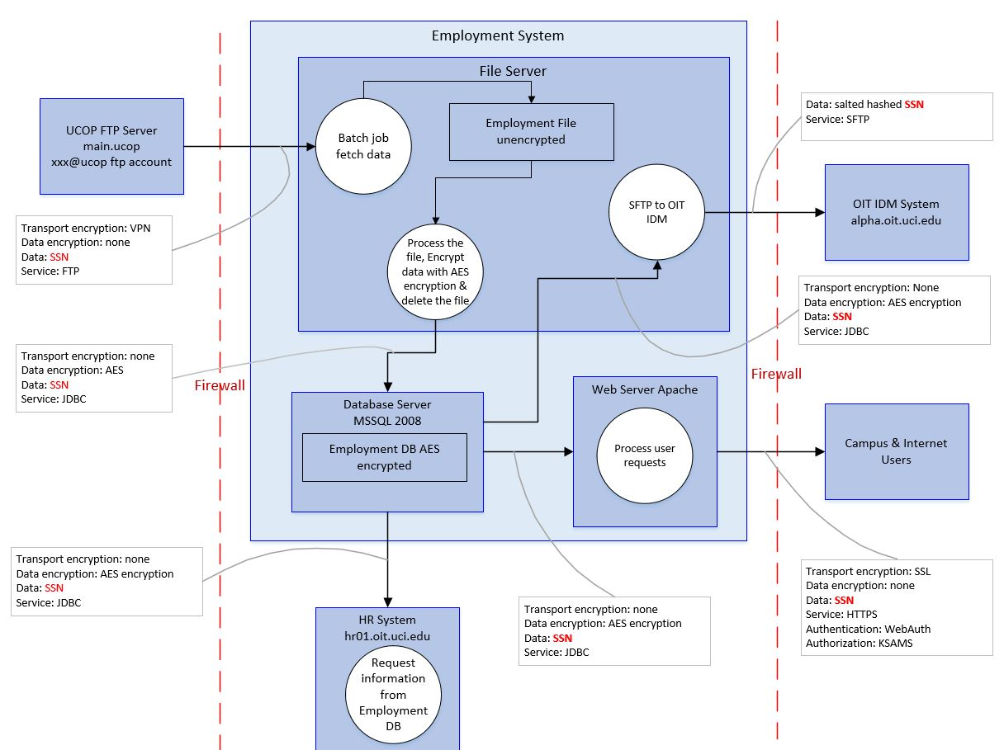
Data flow diagram for an employment system

Slide 7
Employment System Data Flow:
Data originates from UCOP FTP server (SSNs salted/hashed)
Unencrypted data temporarily stored on file server
Data encrypted (AES) before storing in Employment DB (MSSQL)
Web Server Apache handles user requests from database
HR System requests employee info from Employment DB
Security Controls:
VPN secures transport from UCOP FTP server
Firewalls restrict external access to internal systems
Data encrypted (AES) for Storage and data flows
SSL encryption for external user access
Authentication mechanisms (WebAuth, KSAMS)
By addressing these points, we can significantly reduce the risk of data breaches, unauthorized access, and ensure the confidentiality, integrity, and availability of our sensitive employment data.

Slide 8
Vulnerability Resolution Highlights
Closed NFS share, telnet, rlogin and default password vulnerabilities
Regenerated cryptographic keys and certificates
Hardened configurations as per security benchmarks
Outlined challenges with the outdated, unsupported OS
Provided recommendations for further security improvements
This demonstrates our progress and commitment to secure operations.

Slide 9
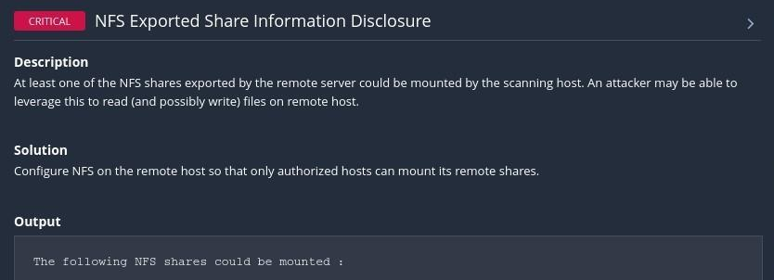
Vulnerabilities Resolution
NFS Exported Share Information Disclosure

Slide 10
To fix the issue of unauthorized access to NFS shares on the Metasploitable VM:
Modify the NFS server configuration on the Metasploitable VM to only allow specific hosts to mount its shares.
sudo nano /etc/exports
Added the entry 10.0.0.2 ip for NFS share, specifying the IP address or range of authorized host and the permission
/etc/exports / 10.0.0.2(rw,sync,no_root_squash)
After updating the `/etc/exports` file, apply the changes by running the following command:
sudo exportfs -ra
sudo /etc/init.d/nfs-kernel-server restart to restart the service

Slide 11
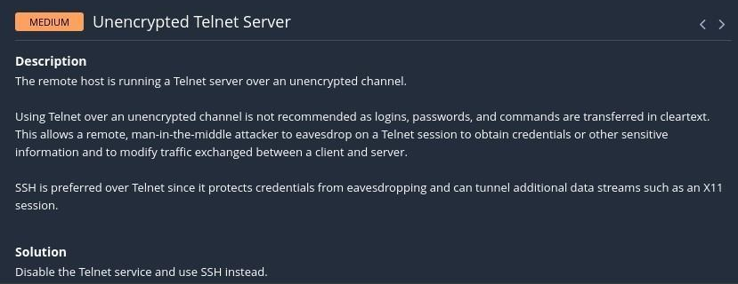
2. Unencrypted Telnet Server

Slide 12
To fix the issue of having an unencrypted Telnet server on Metasploitable VM:
First run the command in the terminal and get into the SSH config file
sudo nano /etc/ssh/sshd_config
So made below service yes to no
PermitRootLogin no
sudo reboot to restart the system.

Slide 13
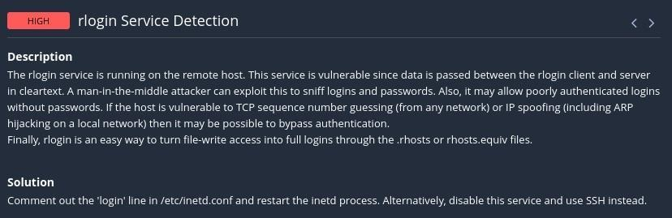
3. rlogin Service Detection

Slide 14
Connected to the Metasploitable VM using SSH
Edit the /etc/inetd.conf file
sudo nano /etc/inetd.conf
Commented below line in the file:
#login stream tcp nowait root /usr/sbin/tcpd /usr/sbin/in.rlogind
Save the changes and exit the text editor.
Restart the inetd process to apply the changes
sudo service inetutils-inetd restart
sudo update-inetd --disable rlogin

Slide 15
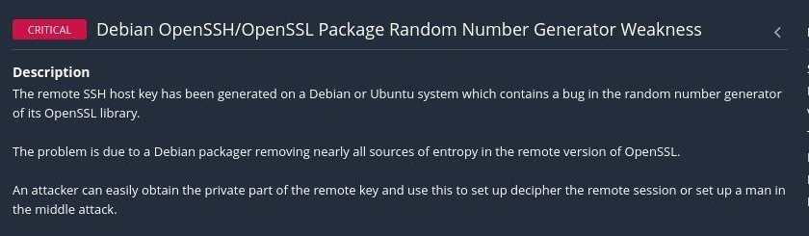
4. OpenSSH/OpenSSL Package Random Number Generator Weakness (SSL check) 32314
Solution: Given this vulnerability, it is crucial to consider all cryptographic material generated on the remote host as guessable. In particular, re-generate all SSH, SSL, and OpenVPN key material to mitigate the risk. For enhanced security, follow these steps: SSH Keys: Generate new SSH key pairs for both the client and server. SSL Certificates: Reissue SSL certificates using a strong random number generator. OpenVPN Keys: Create fresh OpenVPN keys to replace the existing ones.

Slide 16
# Remove existing SSH keys
sudo rm /etc/ssh/ssh_host_*
# Regenerate SSH keys
sudo dpkg-reconfigure openssh-server
Regenerate SSL Certificates:
# Remove existing SSL certificates
sudo rm /etc/ssl/private/ssl-cert-snakeoil.key /etc/ssl/certs/ssl-cert-snakeoil.pem
# Regenerate SSL certificates
sudo make-ssl-cert generate-default-snakeoil --force-overwrite
sudo reboot to restart the system.

Slide 17
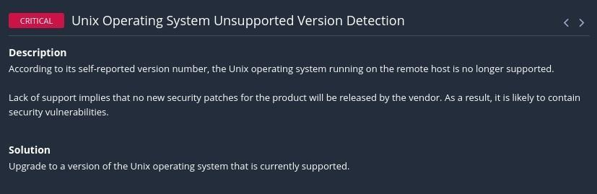
5. Unix operating system unsupported version detected
The detected vulnerability is related to an unsupported version of Ubuntu 8.04. Canonical no longer provides security updates or support for this version since its end of life in 2011. Upgrading to a newer, supported Ubuntu release is recommended. However, if you must continue using Ubuntu 8.04, manual package management or alternative methods are necessary. Upgrading Metasploitable VM 2011 may be challenging due to outdated technology and compatibility issues. Consider migration or additional security measures to ensure reliability and security.

Slide 18
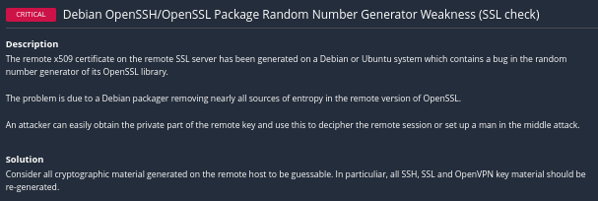
6. Debian OpenSSH/OpenSSL Package Random Number Generator
Remove the existing SSH host keys: sudo rm /etc/ssh/ssh_host_*
Regenerate SSH host keys: sudo dpkg-reconfigure openssh-server

Slide 19
Regenerate SSL certificates: If you're using SSL certificates for any services, such as Apache, Nginx, etc., generate new SSL certificates using a secure method. You may need to refer to the documentation of the specific service you're using.
Restart affected services: After regenerating cryptographic material, restart any affected services to apply the changes. For example, for SSH, you can restart it with:
sudo service ssh restart
Verify the changes: After regenerating keys and certificates, make sure to verify that the new cryptographic material is in use and functioning correctly. Test SSH connections, SSL connections, or any other services that use cryptographic material to ensure they are working as expected.

Slide 20
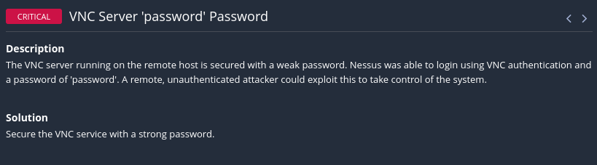
7. VNC server ‘password’ password

Slide 21
Steps taken:
1. Locate the configuration directory:
In many cases, VNC server configuration files are stored in a directory such as /root/.vnc/passwd. used below command to find the .vnc file which has the password details
ls -l ~/.vnc/passwd
2. Edit the .vnc file:
Use a text editor to open the .vnc file. You can use nano, vim, or any other text editor of your choice.
sudo nano /root/.vnc/passwd

Slide 22
3. Locate the line specifying the VNC password:
Search for a line in the vnc.conf file that specifies the VNC password. It might look something like this:
password=COMP@279@group6
4. Restart the system:
Restart the system to ensure that all services, including the VNC server, start up correctly after making changes.
sudo reboot
Result: Successfully we fixed the vnc service vulnerability by defining strong password in /root/.vnc/passwd

Slide 23
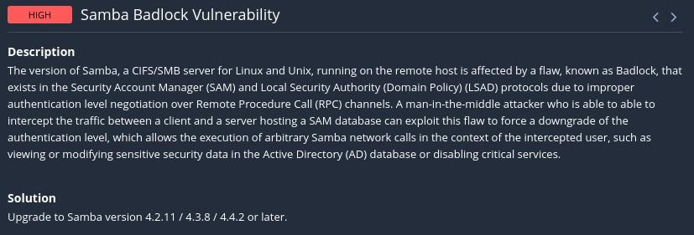
8. Samba Badlock Vulnerability

Slide 24
We used below command to download latest samba service wget http://download.samba.org/pub/samba/samba-latest.tar.gz
After online research it is not possible to update system libraries on an older system like Metasploitable 2011. Above commands have failed on the metasploitable VM. Check below VM results for the command.
Result: We tried above steps and commands but as this metasploitable version is old due to which the system requires SSL Libraries to get updated which is not possible so we cannot fix this vulnerability.

Slide 25
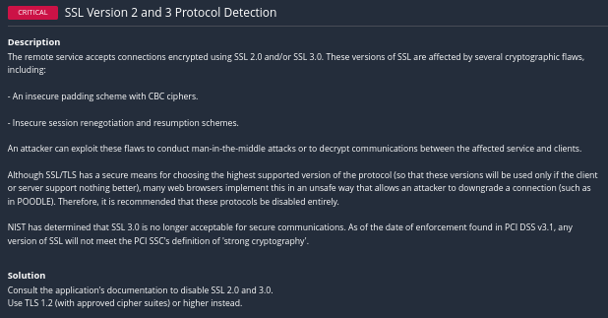
9. SSL Version 2 and 3 Protocol Detection:
Conclusion: We are still unable to generate the certificate files, and the above process creates a self signed certificate and the self signed certificate is not considered safe. Instead we have to take the public key and go to the trusted site like godaddy and they issue the certificate. Then we have to execute the above commands to fix the vulnerability.

Slide 26
10. Msfadmin Password Change (Critical)
It is very critical to change password from default password so that it is not accessible for attackers to login using the default credentials.
Steps taken:
Log In to the VM: Access the Metasploitable VM using the current username and password.
Open a Terminal or Command Prompt: Depending on the operating system of the VM, you'll need to open a terminal or command prompt.
Change Password: Once you have the terminal or command prompt open, you'll use the passwd command to change the password. Type the following command and press Enter:
sudo passwd msfadminb

Slide 27
Enter Current Password: You'll be prompted to enter the current password. Type in the current password and press Enter.
Enter New Password: After entering the current password, you'll be prompted to enter the new password. Type in the new password and press Enter.
Confirm New Password: You'll be asked to confirm the new password by typing it again. Type in the new password once more and press Enter.
Password Changed: If everything was successful, you should see a message indicating that the password has been changed.
Test the New Password: Log out of the Metasploitable VM and log back in using the new password to ensure it was changed successfully.

Slide 28
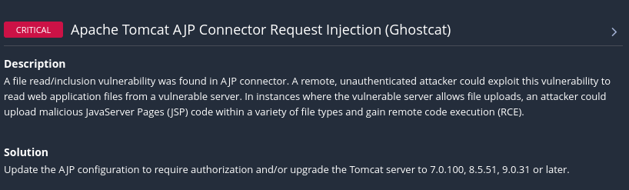
11. Apache Tomcat AJP Connector Request Injection (Ghostcat)

Slide 29
Open Terminal: Access the terminal or command prompt in the Metasploitable VM 2011.
Navigate to Desired Directory: Use the cd command to navigate to the directory where you want to download the Apache Tomcat archive. For example, to download it to the /tmp directory, you can use:
cd /tmp
Download the Latest Version: Use the wget command to download the latest version of Apache Tomcat. You need to provide the URL of the download link. You can find the URL on the Apache Tomcat website.
wget https://downloads.apache.org/tomcat/tomcat-8/v8.5.100/bin/apache-tomcat-8.5.100.tar.gz
Result/Conclusion: We are not able to download the latest Apache Tomcat version due to old SSL certificates. Also, we tried to download the latest SSL certificates but it failed due to VM being obsolete.

Slide 30
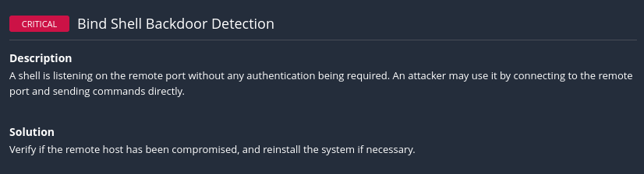
12. Bind Shell Backdoor Detection

Slide 31
Verify System Integrity
Reinstall the System
Apply Security Updates: sudo apt-get update
Harden System Configuration: Implement security best practices to harden the system configuration and minimize the risk of future vulnerabilities. This may include:
Disabling unnecessary services and ports.
Enabling firewall rules to restrict incoming and outgoing traffic.
Configuring strong authentication mechanisms, such as enforcing password policies and using multi-factor authentication where possible.
Regularly monitoring system logs and implementing intrusion detection/prevention systems to detect and respond to suspicious activity.
Regular Security Audits: Conduct regular security audits and vulnerability assessments to identify and address any new security issues that may arise. This will help ensure that the system remains secure over time.

Slide 32
14. (Info) FTP Server Detection
Justification: Isolate the port of FTP to one network
15. (Info) TFTP Daemon Detection
The remote host is running a TFTP (Trivial File Transfer Protocol) daemon. TFTP is often used by routers and diskless hosts to retrieve their configuration. It can also be used by worms to propagate.
Solution: Disable this service if you do not use it.

Slide 33
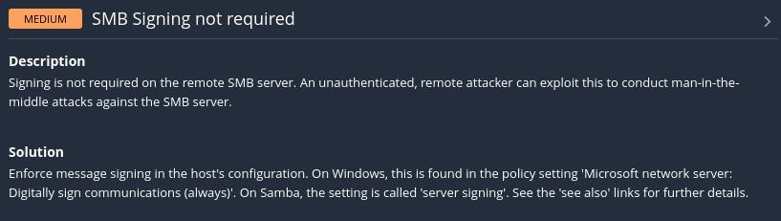
16. SMB Signing not required

Slide 34
Edit the Samba configuration file: Use a text editor to modify the Samba configuration file, typically located at /etc/samba/smb.conf. You may need root privileges to edit this file.
sudo nano /etc/samba/smb.conf
Locate the global section: Within the smb.conf file, find the [global] section where global configuration options are defined. Add or modify the server signing parameter: If the server signing parameter already exists, ensure it is set to "mandatory". If it does not exist, add it under the [global] section.
server signing = mandatory
Save and exit the editor: After making the changes, save the smb.conf file and exit the text editor.
Restart the Samba service: To apply the changes, restart the Samba service using the following command:
sudo service smbd restart

Slide 35
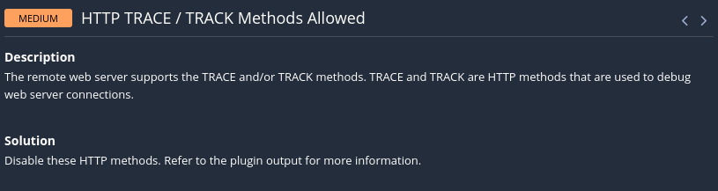
17. HTTP TRACE/TRACK Methods Allowed

Slide 36
To resolve the issue of allowing HTTP TRACE and TRACK methods on your Metasploitable VM 2011, you can follow these steps:
1. Edit the Apache configuration file: Modify the Apache configuration file to disable the TRACE and TRACK methods. The Apache configuration file is typically located at `/etc/apache2/apache2.conf`.
sudo nano /etc/apache2/apache2.conf
2. Locate the `<Directory>` directive for your web directory: Within the Apache configuration file, find the `<Directory>` directive that corresponds to the directory where your web files are located. This is often `/var/www` or similar.

Slide 37
3. Add directives to disable TRACE and TRACK methods: Add the following directives within the `<Directory>` section to explicitly disable the TRACE and TRACK methods:
<Directory /var/www>
# Disable TRACE and TRACK methods
RewriteEngine On
RewriteCond %{REQUEST_METHOD} ^(TRACE|TRACK)
RewriteRule .* - [F]
</Directory>
These directives use mod_rewrite to block any requests using the TRACE or TRACK methods and respond with a "Forbidden" (HTTP 403) status code.

Slide 38
4. Save and exit the editor: After making the changes, save the `apache2.conf` file and exit the text editor.
5. Restart Apache: To apply the changes, restart the Apache service using the following command:
sudo service apache2 restart
6. Verify the configuration: Test whether TRACE and TRACK methods are now disabled by attempting to send requests using these methods. You should receive a "403 Forbidden" response.
By following these steps, you can disable the HTTP TRACE and TRACK methods on your Metasploitable VM 2011, thereby enhancing the security of your Apache web server.

Slide 39
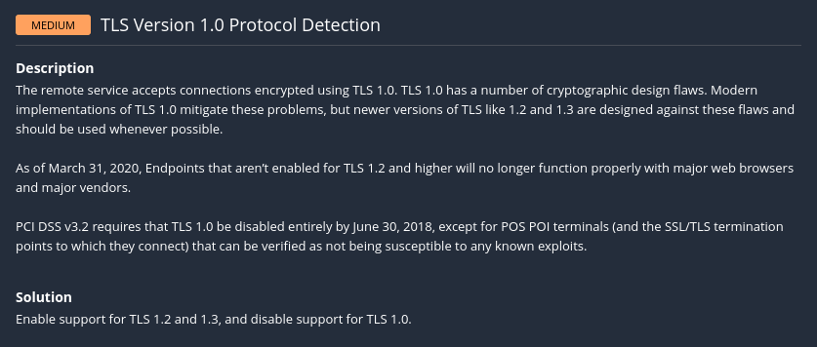
18. TLS Version 1.0 Protocol Detection

Slide 40
Commands used: sudo nano /etc/apache2/apache2.conf
We used the below command to open the apache2/apache2.conf file to add below lines
SSLProtocol TLSv1.2
Conclusion: The above fix needs a new SSL certificate which should be downloaded from the server and installed in the Metasploitable VM. The above process does not accept machine generated self signed certificate.

Slide 41
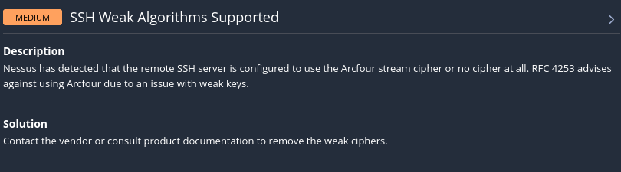
19. SSH Weak Algorithms Supported

Slide 42
Access SSH server configuration:
Log in to the Metasploitable VM using SSH or any other method you prefer.
Navigate to the SSH server configuration file. Typically, it's located at /etc/ssh/sshd_config.
Edit the SSH configuration file:
Open the SSH configuration file using a text editor such as nano or vi. For example:
sudo nano /etc/ssh/sshd_config
Disable weak algorithms:
Search for any lines that reference the Arcfour cipher or any other weak cipher suites. These lines might look like:
Ciphers arcfour

Slide 43
Comment out or remove any lines that include Arcfour or other weak ciphers. You can use stronger ciphers such as AES.
# Ciphers arcfour
Ciphers "aes128-ctr,aes192-ctr,aes256-ctr"
This way, the arcfour cipher is commented out, and the stronger AES ciphers are listed correctly in the sshd_config file.
Restart SSH service:
After making changes, save the configuration file and exit the text editor.
Restart the SSH service to apply the changes:
sudo service ssh restart

Slide 44
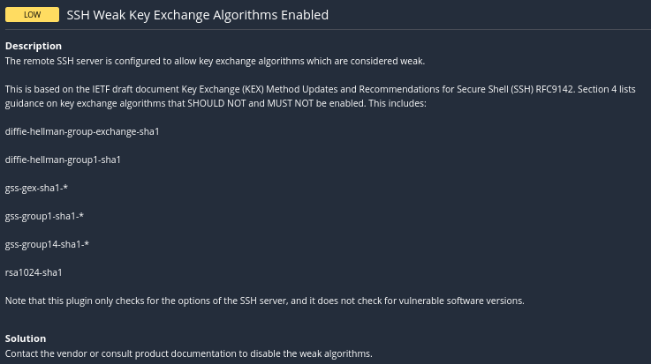
20. SSH Weak Key Exchange Algorithms Enabled

Slide 45
Adding the KexDHMin and KexDHMax directives to the SSHD configuration file, you can further enhance the security of the key exchange process by specifying stronger key exchange algorithms using the KexAlgorithms directive.
Access SSH server configuration:
Log in to the Metasploitable VM via SSH or any other method you prefer.
Navigate to the SSH server configuration file /etc/ssh/sshd_config.
Edit the SSH configuration file:
Open the SSH configuration file using a text editor like nano or vi. For example:
sudo nano /etc/ssh/sshd_config
Add the stronger key exchange algorithms:
KexAlgorithms diffie-hellman-group14-sha256,diffie-hellman-group16-sha512

Slide 46
Save and exit:
Save the changes to the sshd_config file and exit the text editor.
Restart SSH service:
Restart the SSH service to apply the changes:
sudo service ssh restart
By adding the KexAlgorithms directive with stronger key exchange algorithms, you ensure that the SSH server negotiates key exchanges using more secure algorithms, further enhancing the security of your SSH connections.
Conclusion: we are unable to use KexDHMin, KexDHMax, and KexAlgorithms, you can still improve the security of your SSH server by updating to a newer version of OpenSSH if possible. Newer versions often include security enhancements and support for more advanced configuration options.

Slide 47
21. SSL Certificate Required
Conclusion: The fix needs a new SSL certificate which should be downloaded from the server and installed in the Metasploitable.
The below vulnerabilities can be solved after getting a SSL certificate,
SSL Medium Strength Cipher Suites Supported (SWEET32)
SSL Certificate Cannot Be Trusted
SSL Self-Signed Certificate
SSL RC4 Cipher Suites Supported (Bar Mitzvah)
SSL Certificate Expiry
SSL Certificate with Wrong Hostname

Slide 48
Conclusion
By implementing these security measures, ACME Corp will enhance its resilience against cyber threats, protect sensitive data, and demonstrate a commitment to security excellence. I am confident that our efforts will fortify our infrastructure and contribute to the company’s success.

